Slide 1
Analysis of Algorithms
Jeffrey W. Holcomb

Slide 2
Hash Tables

Slide 3
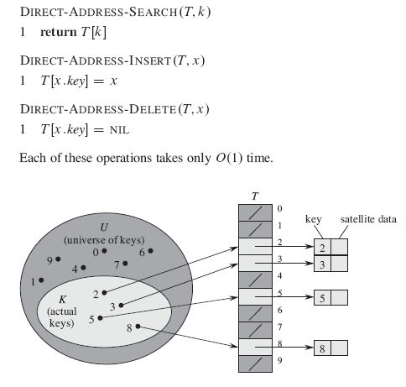


Slide 4

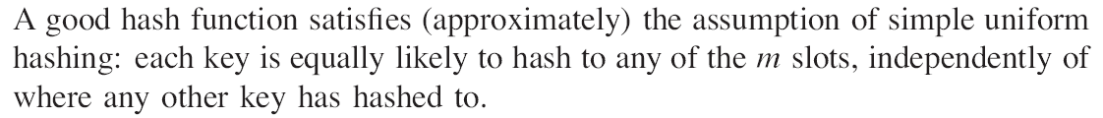

Slide 5
Go over more stuff on hashing

